Slide 1
print(“Hello World!”)
by Double Bs

Slide 2


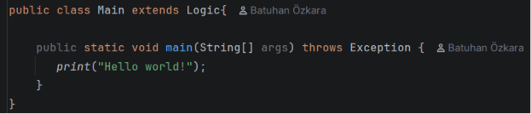
Our goal is simple:

Slide 3
OVERVIEW OF THE PROCESS
01
Start the code
04
Scan QR
02
Quick Pokemon Battle
05
Oh, what’s that?
03
Convince Them.
06
Purified Windows
print(“Hello World!”)
They still think you are a robot.
In order to verify your humanity.
Something’s wrong…
They do not believe you.
DOOM has saved us yet again!

Slide 4
THE WHOLE PROCESS
01
02
03
Starting the code
Pokemon Battle
Captcha
You want to print something, huh? That’s an easy task! Just start your Main program.
Beat Pallosand to verify that you are a human. Very beachy!
The Pokemon battle was won, but the system is still not convinced you are a human.

Slide 5
THE WHOLE PROCESS
04
05
2025
QR Code
Error
DOOM
The captcha was failed. A QR code scan is needed to verify humanity.
Okay, fine, you might be a human. But Windows needs to be deleted in order to run your code.
It will help you. It will save you. It will make you print “Hello World!” to your terminal.
Hint: It works!

Slide 6
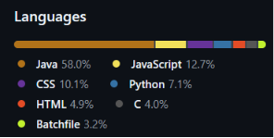
THE DISTRIBUTION
Java for backend
HTML, CSS, and JavaScript for fake captcha and the Pokemon battle.
Python for the DOOM bot AI
Batchfile is dumped through the QR and launches DOOM
C is for unused features we could not implement

Slide 7
Thank You!

